Slide 1


Paul B. Stephens
Title l Annual Meeting
2024-25

Slide 2



All About Title l
Title I is the largest federal assistance program for our nation’s schools.
The program serves 99 schools in Pinellas County including eligible students in 39 non-public schools.
The Title l goal is that every student achieves high levels of academic proficiency.
Notes:
Highlight the Title l Program here in Pinellas County.

Slide 3

School: Paul B. Stephens
Date: August 29, 2024
Time: 6pm
Location: Paul B. Stephens
Principal: Katie Csaszar
2024-25 Title l Annual Parent Meeting
Notes:
Evidence: Upload completed presentation and recorded feedback as part of the evidence to support the Annual Meeting Materials. Do not forget the sign-in sheets, and survey/feedback that you receive throughout the meeting.

Slide 4

Title I Funding Process
2. Florida Department of Education
1. Federal Government
Paul B Stephens School
3. Pinellas County Schools
Notes:
The Florida Department of Education receives funds from the federal government. Districts receive Title I funds from Department of Education, and the school district distributes these funds to schools based on the percentage of children eligible for free/reduced price lunch; however, students do not have to be from low-income families to receive help.

Slide 5


Title l Supplemental Resources
Definition: provided in addition to what is already present or available to compete or enhance it
Notes:
Definition: provided in addition to what is already present or available to complete or enhance it extra academic support and learning opportunities for economically disadvantaged students.

Slide 6


Slide 7


Let’s Celebrate!
Students showed gains in communication with increasing the reliability of their communication method. From Semester 1 to Semester 2 of the 2023-2024 school year there were increases for students who were Emergent communicators growing and becoming Consistent communicators. There were also increases for students growing from Consistent communicators to Reliable communicators. Other gains can be seen in the area of the level of assistance our students require to complete academic tasks.
Notes:
Based on the FAST data and school grades, there is a lot to celebrate!!
How did your Title I Resources support or enhance the work that you were able to get done?

Slide 8
Title I Programs Provide Supplemental Support
Supplemental Resource | Positive Impact
Additional training opportunities for school staff | Professional Development for specific school staff related to assistive technology and other resources to support access to curriculum
Parent and Family Engagement Resources and Training Workshops | Student Planners, MELD boards/communication boards
Notes:
Use additional slides if necessary. This is where you want to really highlight Title I funding and how it positively impacts your scholars! Additional supplemental personnel (add specific positions)
If there are connections that they can make, they call it out!

Slide 9
Title I Schoolwide Planning and Input
First
Second
Last
Seek Input from school, family, and community members determine how Title I funds are used based on a needs assessment.
Please attend online or in-person meetings/trainings and complete surveys to provide input on Title I funding.
All Title I schools must document that parents are involved in the schoolwide planning process.
Notes:
Evidence for input – input from school can be a survey or notes, which include quotes related to what was shared as feedback AND how this input will be used to inform the PFEP and future engagement activities.
Evidence of Attendance – please include attendance of DIVERSE stakeholder group/s.

Slide 10

Title I Schoolwide Budget
Paul B. Stephens is provided $9,400 to pay for supplemental resources and programs for increased student achievement.
Assistive Technology Innovation Association (ATIA) Conference, Student Planners, Communication resources, Family Engagement resources

Slide 11

Parent’s Right to Know
As a parent of a student attending a Pinellas County School Public School, you have the right to…
Be provided information on your child’s level of achievement on assessments in Reading/Language Arts, Writing, Mathematics, and Science.
Request and receive information on the qualifications of your child’s teacher and supplemental personnel working with your child.
Be
Be notified of non-highly qualified or out-of-field teachers at the school.
Be
Be informed if your child is taught by a non-highly qualified teacher for four or more consecutive weeks.
Be

Slide 12
Working Together for Student Success
School
School Improvement Plan (SIP)
Title 1
Title I Schoolwide Plan
Parent
Parent and Family Engagement Plan
School
School-Parent-Student Compact
Title l is now included as a part of the School Improvement Plan
Notes:
As a Title I parent you have the right to be involved in the development of the following plans and documents for our school which can be found on our website (www.pcsb.org/stephens) to view as well as in the Parent Station located (in the front office).
Our school’s Title I Parent Station is located (insert location or photo of Title I Parent Station (front office and on the webpage). Please include photo as part of the evidence monitoring.
You will find a copy of our School Improvement Plan, Title I Schoolwide Plan, School’s PFEP, the School District’s PFEP, Parent’s Right to Know Memo, Upcoming Events, Compact, (at our parent station in the front office)
School Improvement Plan (SIP)
Parent and Family Engagement Plan
Title I Schoolwide Plan
School-Parent-Student Compact

Slide 13

Parent-School-Student Compact
The purpose of the compact is to foster student achievement. By signing the Parent-School-Student Compact, Paul B. Stephens, teachers, staff, parents and students agree to work together to share the responsibility of helping students meet or exceed state, district and school academic goals.
The Parent-School-Student Compact is updated every year to include parent, student, teacher, and staff input. Parent, student, teacher and staff comments are welcome at any time during the year.
Please review and sign your child’s Compact.
Our goal is to receive 100% signed compacts!
Notes:
At the elementary level, school compacts are used as a progress monitoring tool through the year during parent teacher conferences.

Slide 14
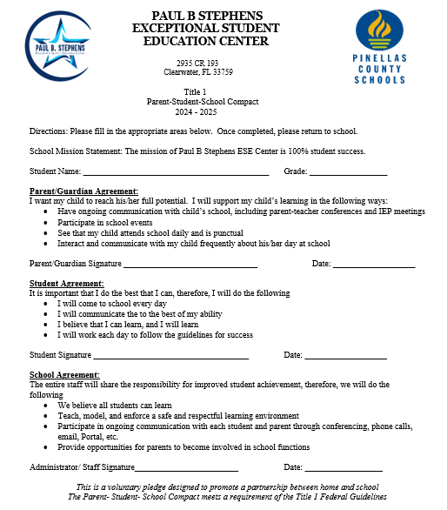
Paul B. Stephens School Compact
Notes:
Please insert the an example of your updated school compact. Highlight any things that unique to your school’s compact.

Slide 15

Parent and Family Engagement Plan (PFEP)
The PFEP Sections include information about the following:
  Parent trainings to increase student achievement
  Staff trainings for engaging parents
  Communication methods between home and school
  Flexible meeting times
  Accessibility for parents
  Coordinating with other Federal Programs
  To access more information on PFEPs, please visit
  www.pcsb.org/titleone
Notes:
Provide information on the specific committees that parents can be involved. Include the purpose, date and time of meetings.
Explain the PFEP and its purpose.
SAC, PTO, VOlunteering
Consider the evidence related Title I Crate, Sample of Evidence,

Slide 16

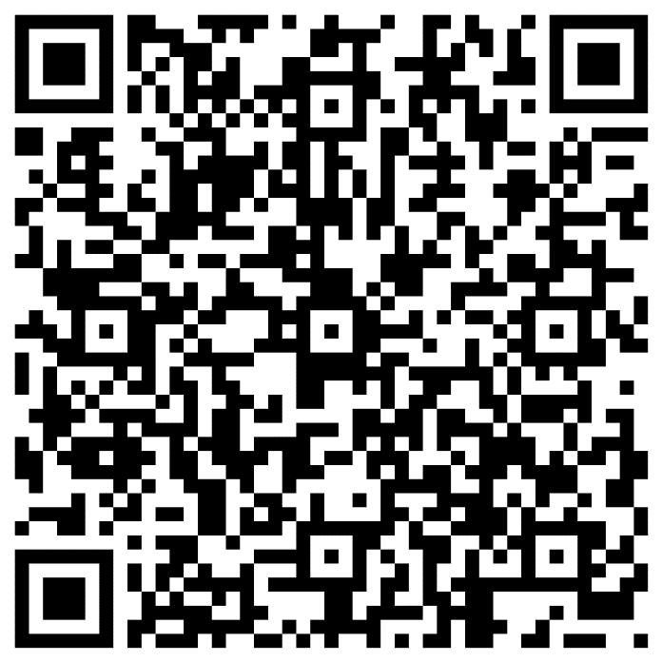
What time is best?
As mentioned in the previous slide, the PFEP ensures to provide families with flexible meeting times.
What time would be best for school events and activities?
Please scan the QR code below to provide input.
Notes:
Evidence – please keep this as evidence to support using feedback to inform flexible meetings.

Slide 17

  School Report Cards
  School Grade and Overview
  Population and Enrollment
  Assessments – Academic Achievement, Growth, and Population
  Assessments – English Language Learners
  Graduation and Beyond
  Educator Qualifications and Equity
  Long-Term Goals and Interim Progress
  Per-Pupil Expenditures
  National Data
  Available online at https://edudata.fldoe.org/ or Front Office

Slide 18

Student Assemblies (last Friday of each month): September 27th
Trunk or Treat: October 29th
Thanksgiving Lunch: November 21st
Holiday Musical & Holiday Market: December 13th
Walk and Roll-a-thon: March 14th
Spring Performance: April 11th
Notes:
Do you have a calendar of key events that are included in your PFEP.
Evidence – Consider this as evidence to include to support Family Engagement.

Slide 19
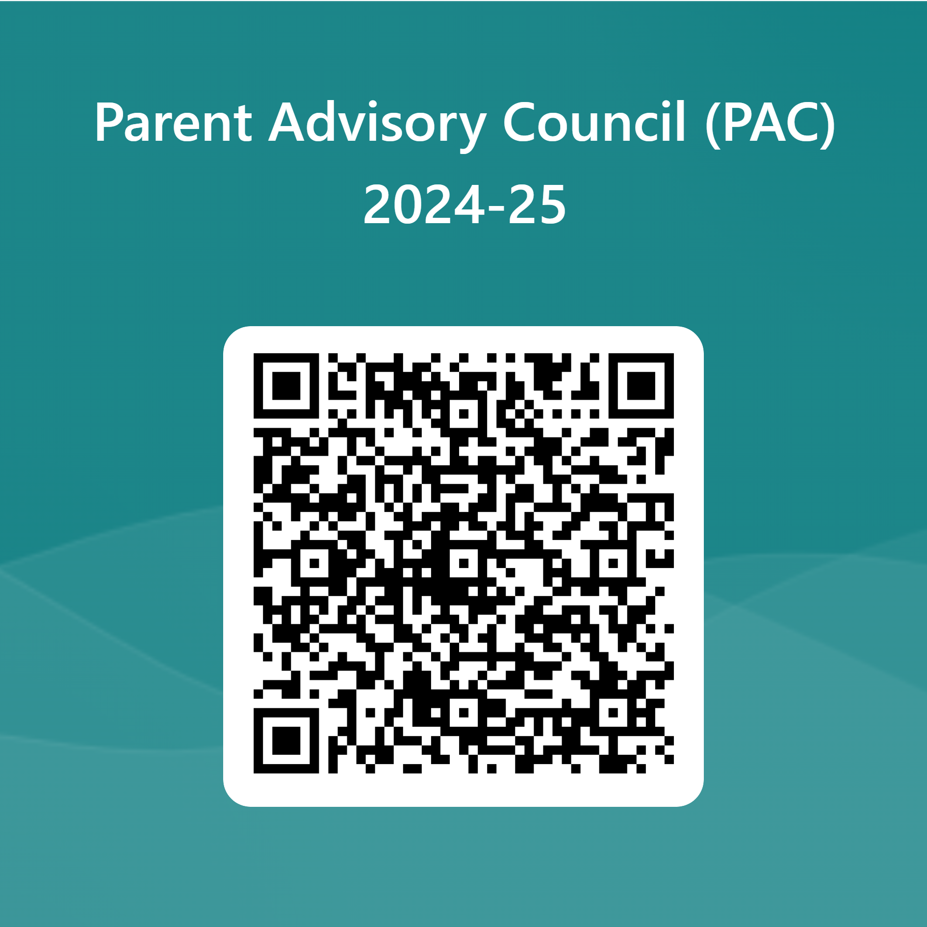

Parent Advisory Council (PAC)
The District has a Parent and Family Engagement Plan. The summary of the plan is in the Title I School & Family Partnership Overview.
You may access the full plan at www.pcsb.org/titleone
The Parent Advisory Council (PAC) is responsible for reviewing and revising the District PFEP.
PAC will meet virtually or in person with the district’s Title I staff.
Each school is committed to having at least one member representative in PAC.
PAC meets twice a year, if you are interested in representing our school please notify, Insert contact person
Notes:
Please add your PAC representative in slide and share with your Title I Specialist.
https://forms.office.com/r/r5daaMTENE\

Slide 20
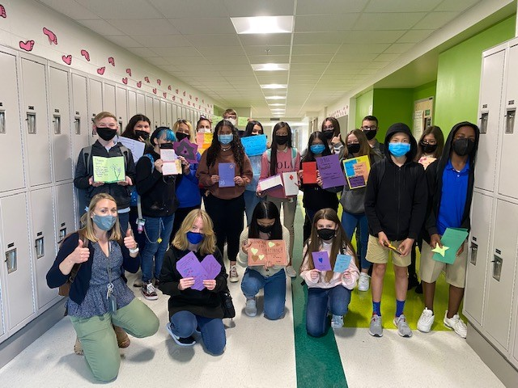

Additional Resources
Learning at Home Family Resources - https://www.pcsb.org/Page/32836
Volunteer in a Pinellas County School - https://www.pcsb.org/Page/459
Parent Academy POWER HOURS Webinars - https://www.pcsb.org/Page/26534
Partnerships - https://www.pcsb.org/Page/418

Slide 21

Thank you for your time!

Slide 22


Slide 23
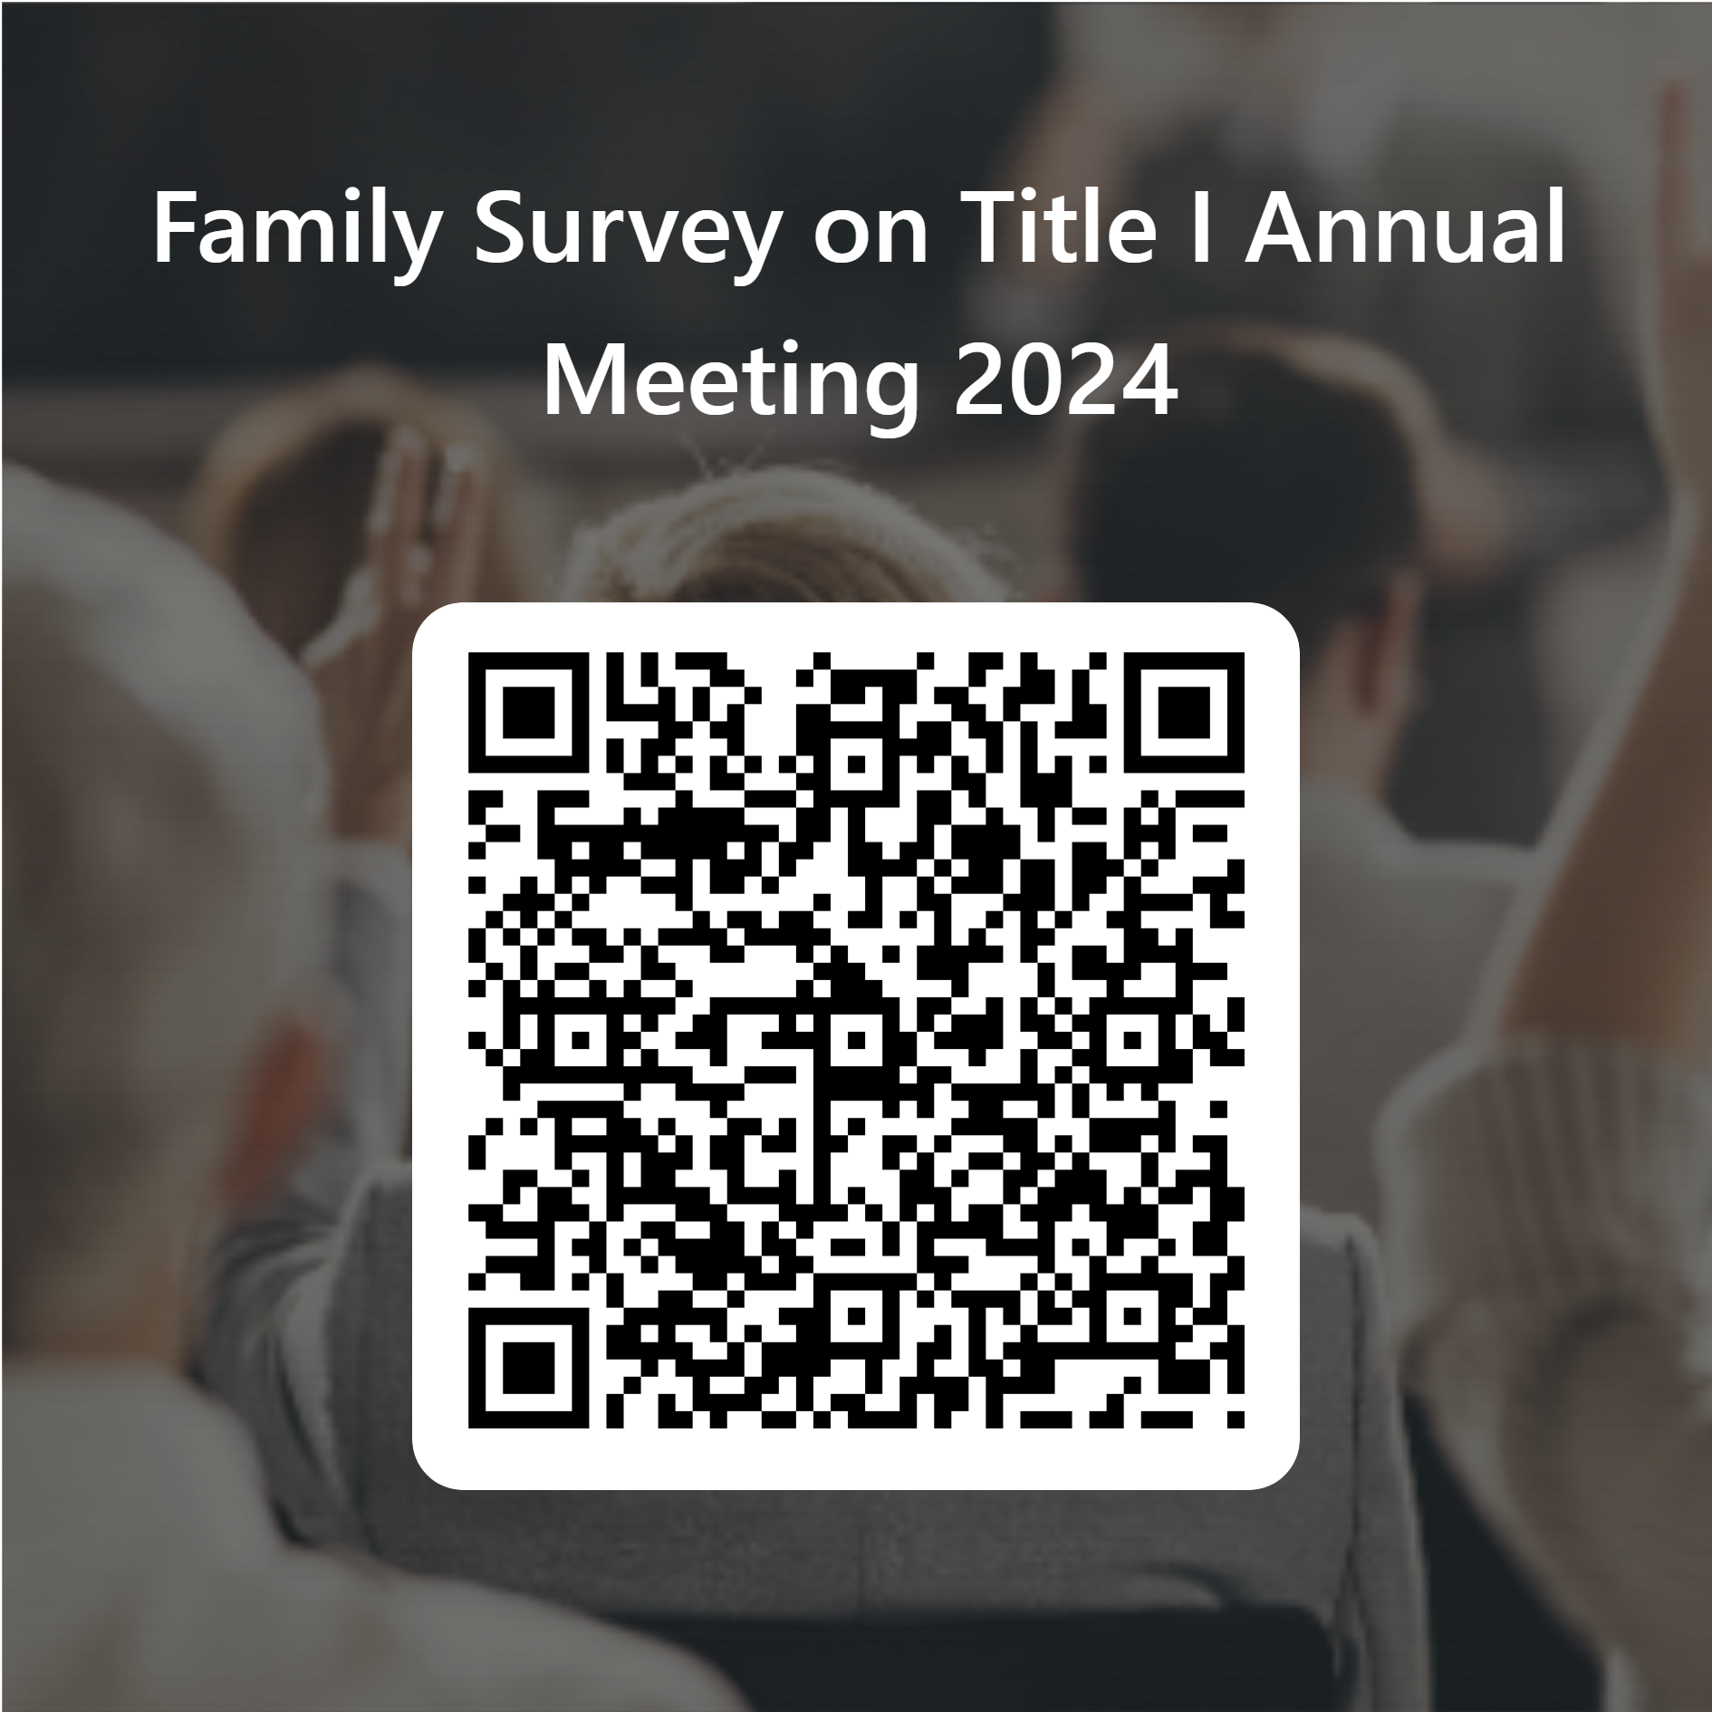
Please take the time to participate in our survey.
See notes for details.
Your feedback is greatly appreciated!
Notes:
Please duplicate Microsoft Forms provided or create school survey. To generate a QR code hover over your school’s survey and and right click. Create QR code for this page will be an option.
https://forms.office.com/Pages/ShareFormPage.aspx?id=BZM8c9c5GkaGb_3ye_PH_x-1YNVO6C1FkgA88U6PR2tUNEQzTU0wNkZXVUxVTlpEMU81NkJFMlJNTi4u&sharetoken=FXXhmgwFjSnl0sNz61ki

